Slide 1
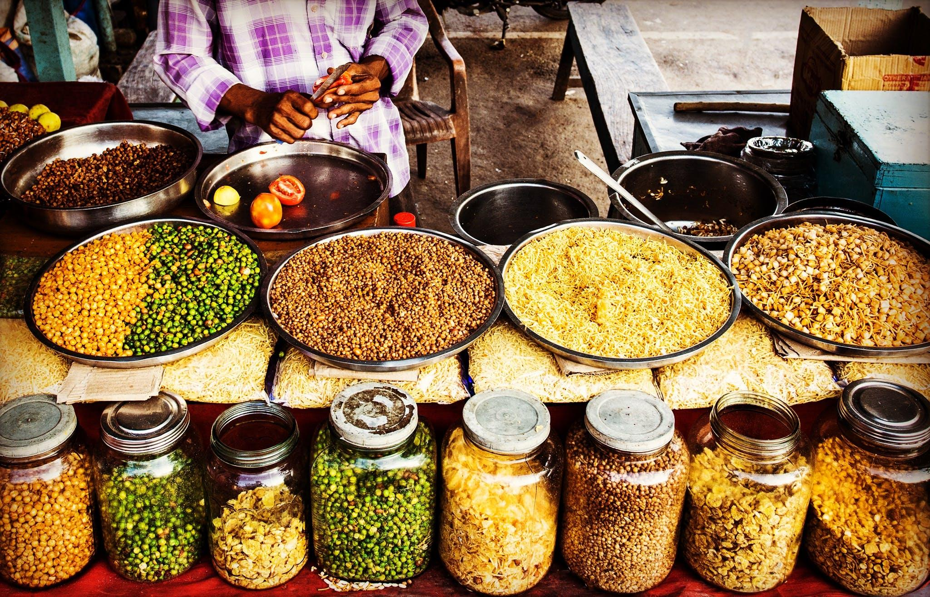

Affordable Nourishment
An analysis of food price fluctuation in the global south.

Slide 2
Who?
Development consulting
Our mission
To harness the power of data and analytics to improve the lives of citizens and promote social well-being. We believe that by providing governments with the tools and knowledge they need, we can make a meaningful impact on society.

Slide 3

Data for a meaningful impact

Slide 4
What we do?
Identify the critical price increases locations and commodities for action.
Support public authorities in their decision making with specific targets.
Advocate for a more affordable nourishment where needed.
Create positive impact!
Analysis of price evolution by commodity in a variety of countries from 1997 to 2017.

Slide 5
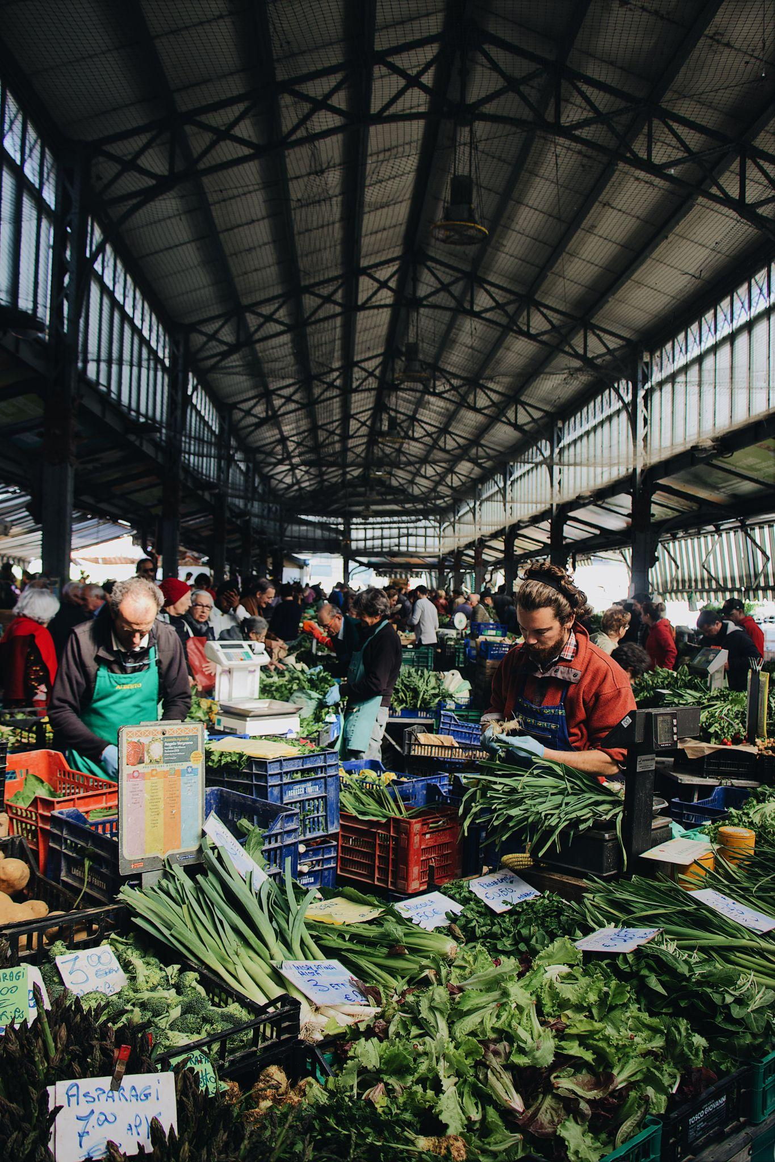
Unlock data potential for a meaningful impact!

Slide 6

Thank you!

